Slide 1
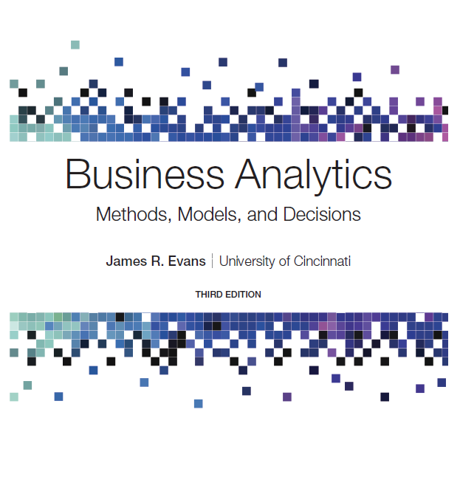
Business Analytics: Methods, Models, and Decisions
Third Edition
Chapter 14
Integer and Nonlinear Optimization
Copyright © 2020, 2016, 2013 Pearson Education, Inc. All Rights Reserved
Notes:
If this PowerPoint presentation contains mathematical equations, you may need to check that your computer has the following installed:
1) MathType Plugin
2) Math Player (free versions available)
3) NVDA Reader (free versions available)

Slide 2
Integer Optimization
An integer linear optimization model (integer program) is a linear model in which some or all variables are restricted to being whole numbers.
Decision variables that we force to be integers are called general integer variables.
Many optimization models require binary variables, which are variables that are restricted to being either 0 or 1:
Binary variables are used to model logical yes-or-no decisions.

Slide 3
Models with General Integer Variables
Algorithms for integer optimization models first solve the L P relaxation (no integer restrictions imposed) and gradually enforce integer restrictions using systematic searches.
Solver has a default integer tolerance of 0.05 so it will stop if it finds an integer solution within 5% of the optimal solution.
To find the guaranteed optimal integer solution, Integer Tolerance must be set to 0. Click the Options button in the Solver Parameters dialog and ensure that the value of Integer Optimality (%) is 0.

Slide 4
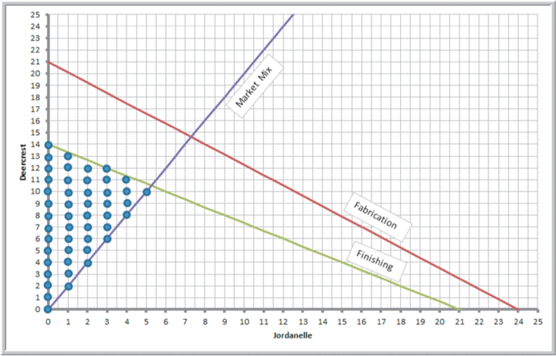
Example 14.1: Sklenka Skis Revisited (1 of 3)
The optimal solution was to produce 5.25 pairs of Jordanelle skis and 10.5 pairs of Deercrest skis.
Feasible integer solutions are shown on the accompanying graph.

Slide 5
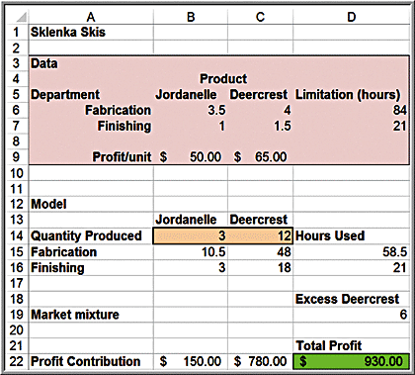
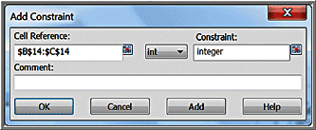
Example 14.1: Sklenka Skis Revisited (2 of 3)
To enforce integer restrictions on variables using Solver, click the Add button to add a constraint. In the Add Constraint dialog, enter the variable range in the Cell Reference field and choose int from the drop-down box, which places the word “integer” in the Constraint field.
The maximum value of the objective function for the model with integer restrictions is smaller than the linear optimization solution. Whenever you add a constraint to a model, the value of the objective function can never improve and usually worsens.

Slide 6
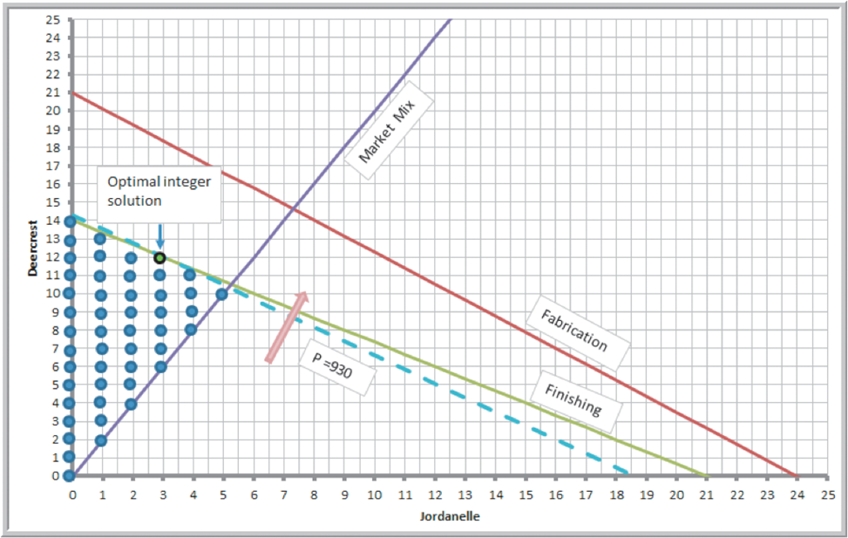
Example 14.1: Sklenka Skis Revisited (3 of 3)
Graphical illustration of optimal integer solution
Note that rounding the original solution is not optimal.

Slide 7
Example 14.2: A Cutting-Stock Problem (1 of 2)
A company makes 110-inch wide rolls of thin sheet metal and slices them in smaller rolls of 12, 15, and 30 inches.
A cutting pattern is a configuration of the number of smaller rolls of each type that are cut from the raw stock. Six different cutting patterns are used.
Size of End Item
Pattern | 12 inches. | 15 inches. | 30 inches. | Scrap
1 | 0 | 7 | 0 | 5 inches.
2 | 0 | 1 | 3 | 5 inches.
3 | 1 | 0 | 3 | 8 inches.
4 | 9 | 0 | 0 | 2 inches.
5 | 2 | 1 | 2 | 11 inches.
6 | 7 | 1 | 0 | 11 inches.
Demands for the coming week are 500 12-inch rolls, 715 15-inch rolls, and 630 30-inch rolls.
The problem is to develop a model that will determine how many 110-inch rolls to cut into each of the six patterns to meet demand and minimize scrap.

Slide 8
Example 14.2: A Cutting-Stock Problem (2 of 2)
Model development
Size of End Item
Pattern | 12 inches. | 15 inches. | 30 inches. | Scrap
1 | 0 | 7 | 0 | 5 inches.
2 | 0 | 1 | 3 | 5 inches.
3 | 1 | 0 | 3 | 8 inches.
4 | 9 | 0 | 0 | 2 inches.
5 | 2 | 1 | 2 | 11 inches.
6 | 7 | 1 | 0 | 11 inches.
= number of 110-inch rolls to cut using pattern i
needs to be a whole
number (general integer variable) because each roll that is cut generates a different number of end items.
The only constraints are end-item demand, nonnegativity, and integer restrictions.

Slide 9
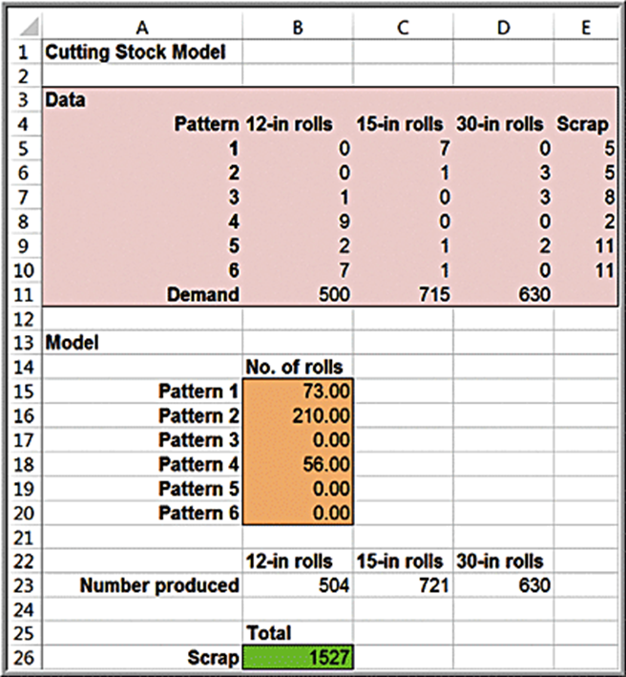
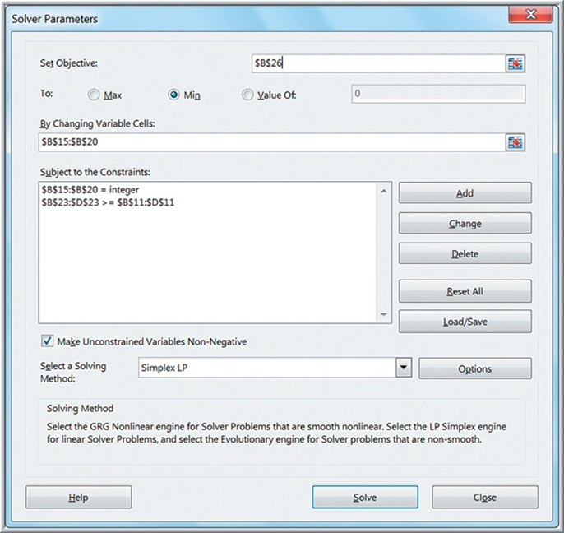
Spreadsheet Implementation and Solver Model for the Cutting-Stock Model

Slide 10
Workforce-Scheduling Models
Workforce scheduling is a practical, yet highly complex, problem in many businesses such as food service, hospitals, and airlines.
Typically a huge number of possible schedules exist and customer demand varies by day of week and time of day, further complicating the problem of assigning workers to time slots.

Slide 11
Example 14.3: Brewer Services (1 of 2)
Brewer Services schedules customer service workers on Monday to Friday, 8 a.m. to 5 p.m.
Staffing requirements are shown in the table.
5 permanent employees work all day.
Part-time employees work 4-hour shifts.
What is the minimum number of part-time employees needed to meet staffing requirements?
Hour | Minimum Staff Required
8-9 | 5
9-10 | 12
10-11 | 15
11-Noon | 12
Noon-1 | 11
1-2 | 18
2-3 | 17
3-4 | 19
4-5 | 14

Slide 12
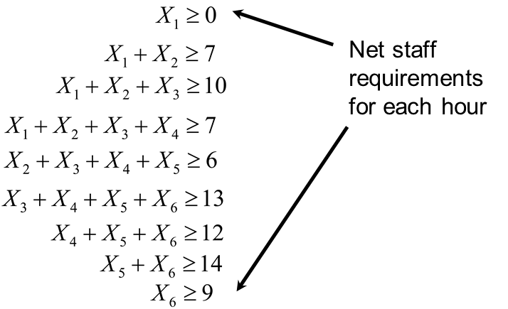
Example 14.3: Brewer Services (2 of 2)
Model development
= integer number of part-time workers that start on the i^{th} 4-hour shift
Constraints: For each hour, we need to ensure that the total number of part-time employees who work that hour is at least as large as the minimum requirements.
Hour | Minimum Staff Required
8-9 | 5
9-10 | 12
10-11 | 15
11-Noon | 12
Noon-1 | 11
1-2 | 18
2-3 | 17

Slide 13
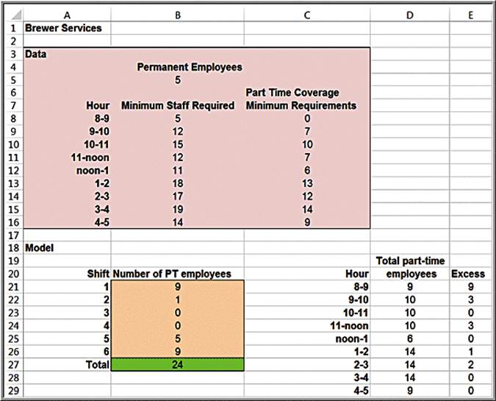
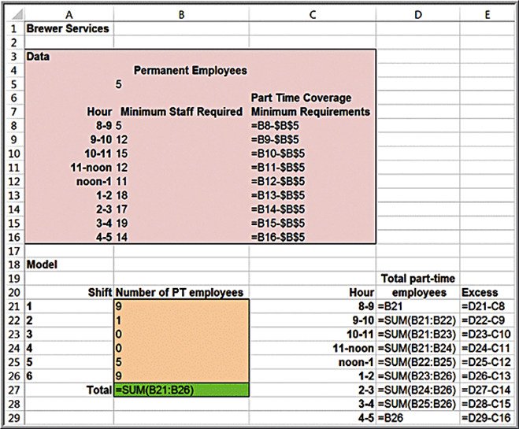
Spreadsheet Implementation for Brewer Services

Slide 14
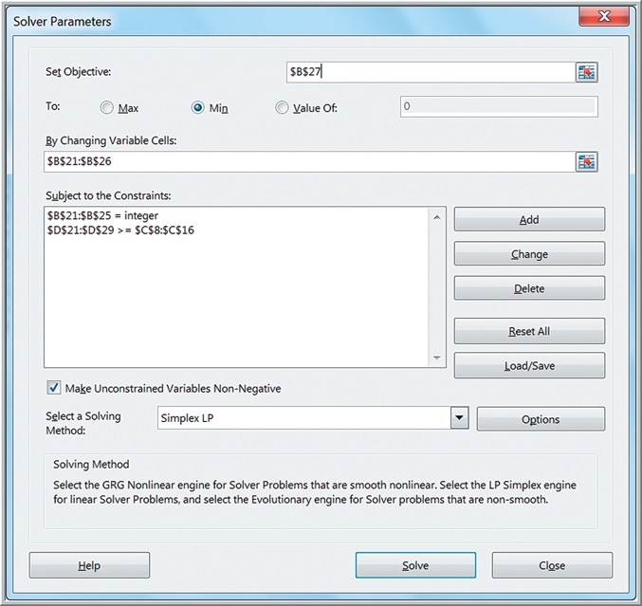

Solver Model for Brewer Services

Slide 15
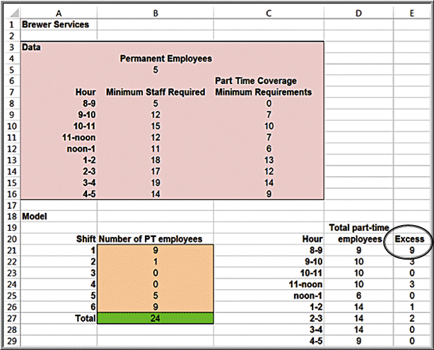
Example 14.4: Finding Alternative Optimal Solutions for Brewer Services Model (1 of 3)
The solution has 9 excess employees at 8 a.m., which may not be desirable.
Most scheduling problems have multiple optimal solutions.
An easy way to find an alternative optimal solution is to add an additional constraint with the objective function equal to the optimal solution value:
and then set the new objective function to minimize the number of excess employees at 8 a.m.

Slide 16
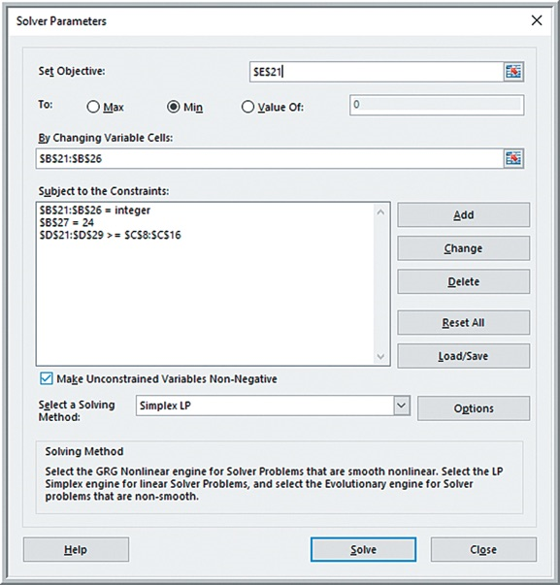
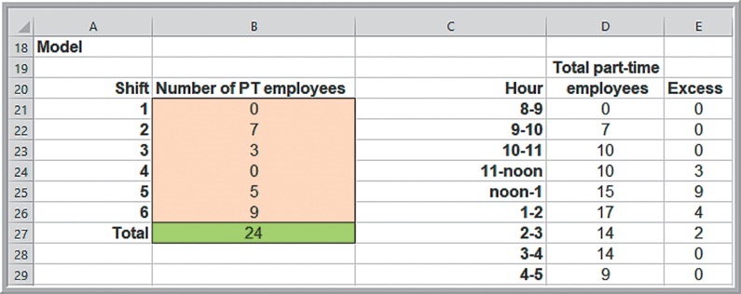
Example 14.4: Finding Alternative Optimal Solutions for Brewer Services Model (2 of 3)
Modified Solver model and Alternative Optimal Solution
However, now we have 9 excess employees at noon.

Slide 17
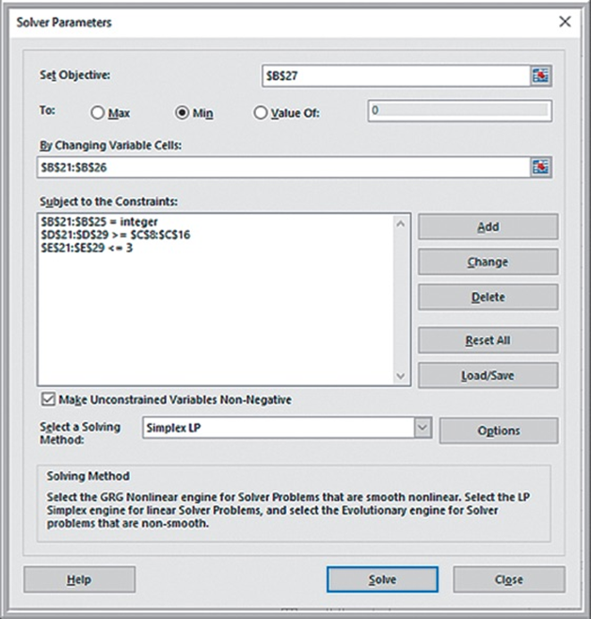
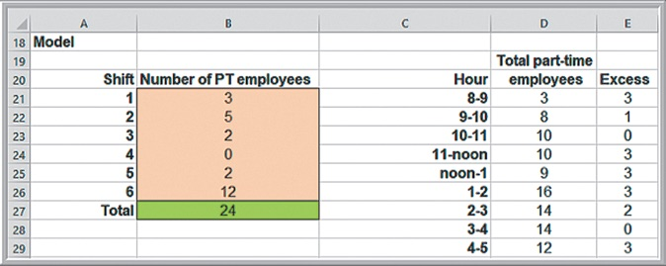
Example 14.4: Finding Alternative Optimal Solutions for Brewer Services Model (3 of 3)
A better approach would be to define additional constraints to restrict the excess number of
employees in the range
to be less than or equal to some maximum number k and then attempt to minimize the original objective function.
The smallest value of k that results in a feasible solution is k = 3.

Slide 18
Models with Binary Variables
Project selection - finding the best subset of potential projects that must be selected with limited resource constraints.
Capital-budgeting problems in finance have a similar structure.

Slide 19
Example 14.5: Hahn Engineering (1 of 3)
Project selection model
Five potential projects are being considered. Each project is expected to generate a return (given by the net present value) but requires a fixed amount of cash and personnel.
Blank | Project 1 | Project 2 | Project 3 | Project 4 | Project 5 | Available Resources
Expected return (N P V) | $180,000 | $220,000 | $150,000 | $140,000 | $200,000 | Blank
Cash requirements | $55,000 | $83,000 | $24,000 | $49,000 | $61,000 | $150,000
Personnel requirements | 5 | 3 | 2 | 5 | 3 | 12
The available budget and human resources do not allow selection of all 5 projects.
The objective is to maximize expected return.

Slide 20
Example 14.5: Hahn Engineering (2 of 3)
Model development
Define
as binary:
if project i is selected;
if project i
not selected.
Maximize
Cash limitation:
Personnel limitation:
Blank | Project 1 | Project 2 | Project 3 | Project 4 | Project 5 | Available Resources
Expected return (N P V) | $180,000 | $220,000 | $150,000 | $140,000 | $200,000 | Blank
Cash requirements | $55,000 | $83,000 | $24,000 | $49,000 | $61,000 | $150,000
Personnel requirements | 5 | 3 | 2 | 5 | 3 | 12

Slide 21
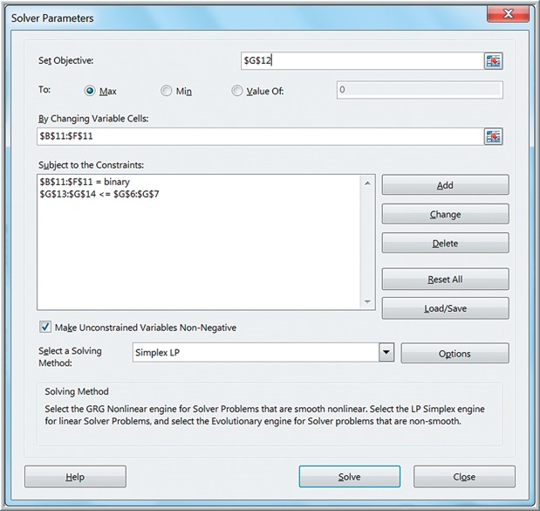
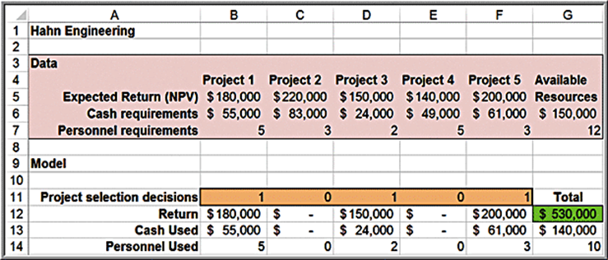
Example 14.5: Hahn Engineering (3 of 3)
Spreadsheet implementation and Solver model

Slide 22
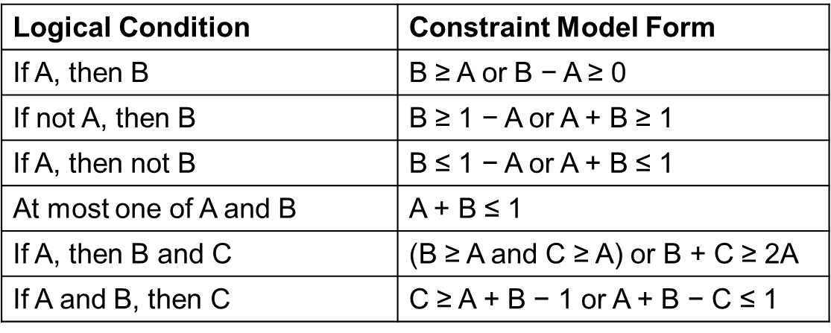
Using Binary Variables to Model Logical Constraints
Examples
If project 1 is selected, then project 4 must also be selected.
Excel IF functions, while logical, cannot be used in linear optimization.
Model this as
If
then
is forced to be 1.
Other types of logical constraints:

Slide 23
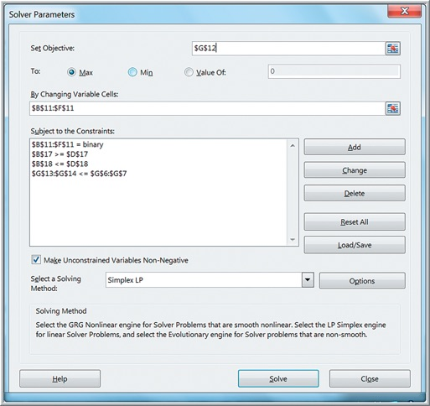
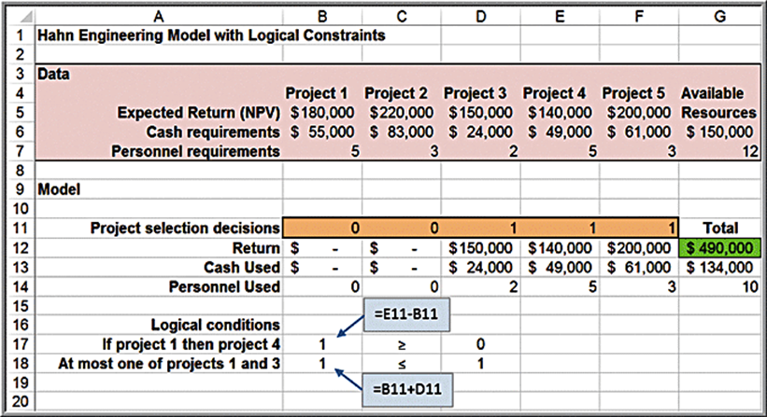
Example 14.6: Adding Logical Constraints into the Project-Selection Model
Suppose project managers want to ensure that:
If project 1 is selected, then project 4 is also selected:
At most one of projects 1 and 3 can be selected:
Define a cell for each constraint function (cells B17 and B18).

Slide 24
Applications in Supply Chain Optimization
Supply chain optimization is one of the broadest applications of integer optimization and is used extensively today as companies seek to reduce logistics costs and improve customer service in tough economic environments.

Slide 25
A Supply Chain Optimization Problem
A company has numerous potential locations for distribution centers to ship products to customers.
A single-sourcing policy specifies that each customer can only be supplied from one distribution center.
The problem is to determine which customers to assign to each distribution center.

Slide 26
Customer-Assignment Optimization Model
Define
if customer j
is assigned to distribution
center i;
if not.
if distribution center
i is selected as a location;
if not.
= total cost of
satisfying the demand of customer j from distribution center i
k = number of distribution centers to be selected

Slide 27
Example 14.7: Paul & Giovanni Foods (1 of 3)
Distributes restaurant supplies in 5 major cities.
Four possible locations for distribution centers have been identified.
P G Foods wants to determine the supply chain configuration that minimizes sourcing costs.
Sourcing Costs | Houston | Las Vegas | New Orleans | Chicago | San Francisco
Los Angeles | $40,000 | $11,000 | $75,000 | $70,000 | $60,000
Denver | $72,000 | $77,000 | $120,000 | $30,000 | $75,000
Pensacola | $24,000 | $44,000 | $45,000 | $80,000 | $90,000
Cincinnati | $32,000 | $55,000 | $90,000 | $20,000 | $105,000

Slide 28
Example 14.7: Paul & Giovanni Foods (2 of 3)
Model development
Sourcing Costs | Houston | Las Vegas | New Orleans | Chicago | San Francisco
Los Angeles | $40,000 | $11,000 | $75,000 | $70,000 | $60,000
Denver | $72,000 | $77,000 | $120,000 | $30,000 | $75,000
Pensacola | $24,000 | $44,000 | $45,000 | $80,000 | $90,000
Cincinnati | $32,000 | $55,000 | $90,000 | $20,000 | $105,000
if city j is
assigned to distribution center i
if distribution
center i is selected as a location
k = number of distribution centers to be selected

Slide 29
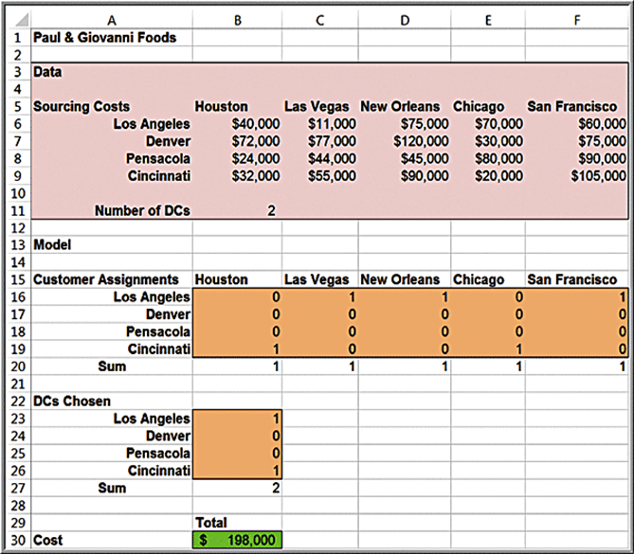
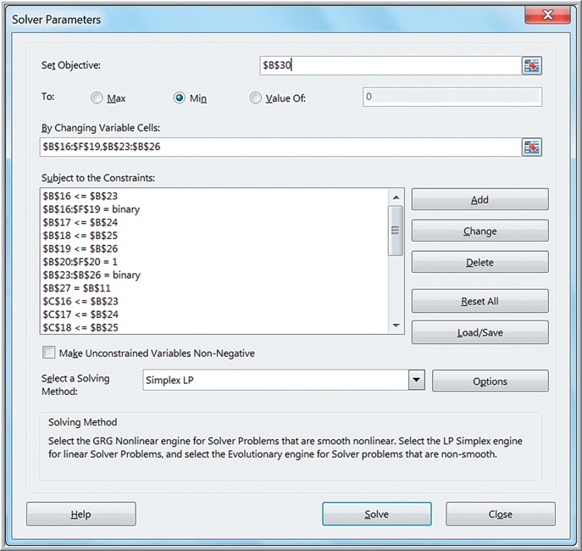
Example 14.7: Paul & Giovanni Foods (3 of 3)
Spreadsheet and Solver model

Slide 30
Modeling and Solving Nonlinear Optimization Problems
A nonlinear optimization model is one in which the objective function and/or at least one constraint is nonlinear. Nonlinear models are generally more difficult to develop.
Building nonlinear optimization models relies on fundamental modeling principles, such as business logic to identify the appropriate functional relationships among the decision variables or empirical data and line-fitting techniques to characterize the nonlinearities.

Slide 31
A Nonlinear Pricing Decision Model
Sales = −2.9485 * Price +3,240.92
Identify the price that maximizes total revenue, subject to any constraints that might exist.

Slide 32
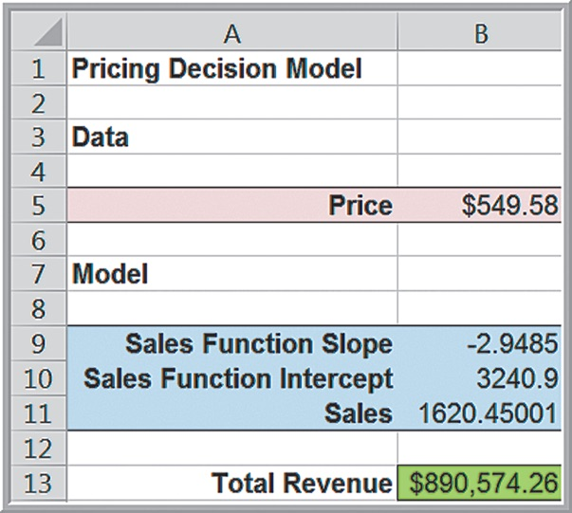
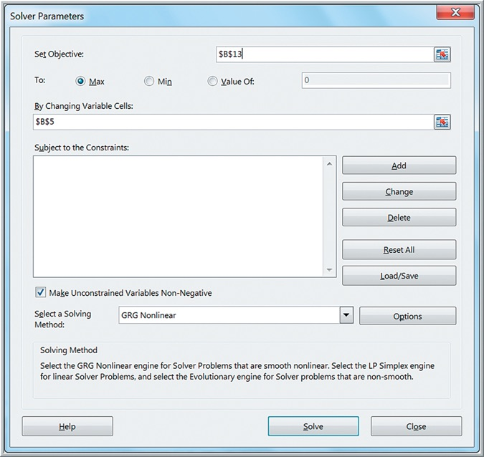
Example 14.8: Solving the Pricing Decision Model
Spreadsheet and Solver model

Slide 33
Example 14.9: A Hotel Pricing Model (1 of 5)
The Marquis Hotel is considering a major remodeling effort and needs to determine the best combination of rates and room sizes to maximize revenues while keeping the number of rooms at or below the current capacity of 450.
Room Type | Rate | Daily Avg. No. Sold | Revenue
Standard | $85 | 250 | $21,250
Gold | $98 | 100 | $9,800
Platinum | $139 | 50 | $6,950
Total Revenue | Blank | Blank | $38,000
Room Type | Price Elasticity of Demand
Standard | −1.5
Gold | −2.0
Platinum | −1.0

Slide 34
Example 14.9: A Hotel Pricing Model (2 of 5)
Room Type | Rate | Daily Avg. No. Sold | Revenue
Standard | $85 | 250 | $21,250
Gold | $98 | 100 | $9,800
Platinum | $139 | 50 | $6,950
Total Revenue | Blank | Blank | $38,000
Room Type | Price Elasticity of Demand
Standard | −1.5
Gold | −2.0
Platinum | −1.0
Projected number of rooms sold for a given room type =
For example, using a standard room:
projected number of rooms sold
where S = new Standard room price

Slide 35
Example 14.9: A Hotel Pricing Model (3 of 5)
Model

Slide 36
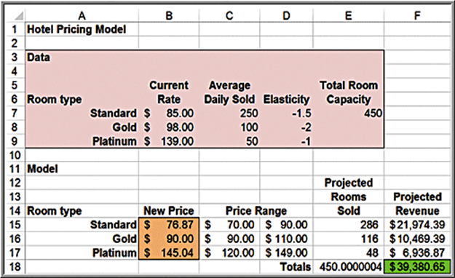
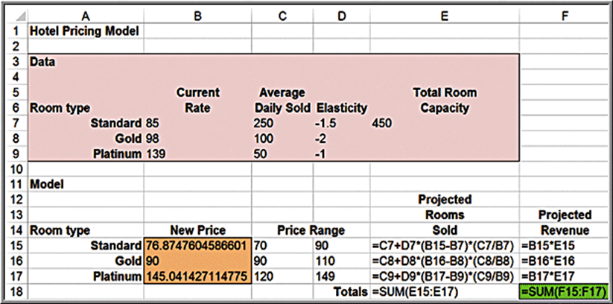
Example 14.9: A Hotel Pricing Model (4 of 5)
Spreadsheet model

Slide 37
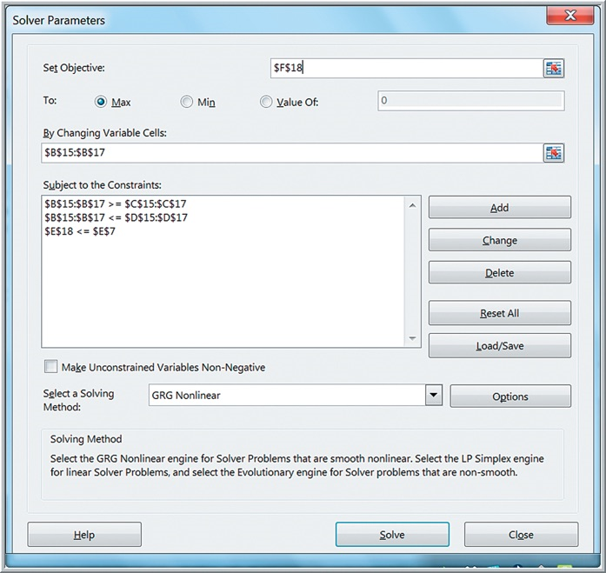
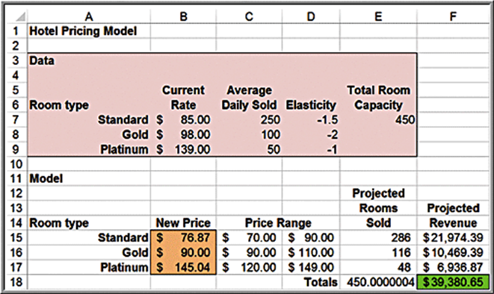
Example 14.9: A Hotel Pricing Model (5 of 5)
Solver model

Slide 38
Quadratic Optimization
A quadratic optimization model is one that has a quadratic objective and all linear constraints.
Recall from algebra that a quadratic function is
In other words, a quadratic function has only constant, linear, and squared terms.
Quadratic optimization models can be solved using the Standard L P/Quadratic solving method within Solver.

Slide 39
The Markowitz Portfolio Model
The Markowitz portfolio model is a classic quadratic optimization model in finance that seeks to minimize risk of an investment portfolio subject to a constraint on the portfolio’s expected return.
Risk is measured using variances and covariances of the individual investments.

Slide 40
Model Development
fraction of the portfolio invested in stock i
The risk of a portfolio is weighted sum of the variances and covariances
where
the sample variance in the return of stock i
the sample covariance between stocks i and j

Slide 41
Example 14.10: An Example of the Markowitz Model
An investor is considering 3 stock investments.
Variance-covariance matrix
Blank | Stock 1 | Stock 2 | Stock 3
Stock 1 | 0.025 | 0.015 | −0.002
Stock 2 | Blank | 0.030 | 0.005
Stock 3 | Blank | Blank | 0.004
Expected Returns
Stock 1: 10%
Stock 2: 12%
Stock 3: 7%

Slide 42
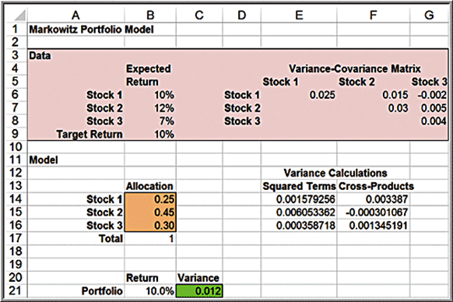
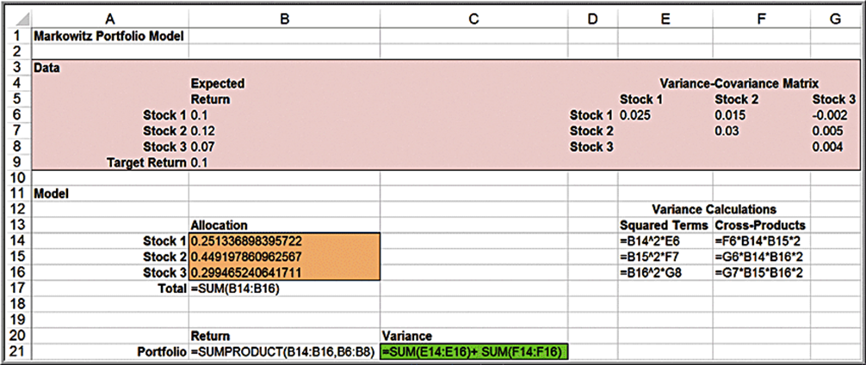
Spreadsheet Model

Slide 43
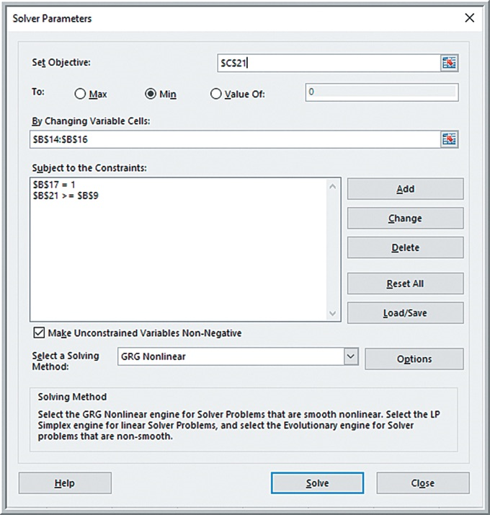

Solver Model

Slide 44
Non-Smooth Optimization
Excel functions IF, ABS, MAX, MIN lead to non-smooth models (that violate linearity conditions).
Solver’s Evolutionary algorithm can be used to solve non-smooth models using a heuristic solution approach.
Heuristics are intelligent rules for systematically searching among solutions in attempting to find better solutions.

Slide 45
Example 14.11: Incorporating Fixed Costs into the K&L Designs Model
K&L Designs (Example 13.19). The company must rent some equipment, which costs $65 for three months.

Slide 46
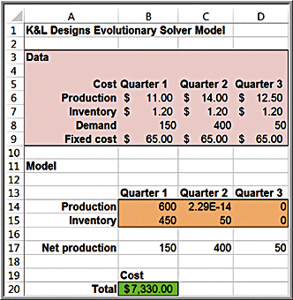
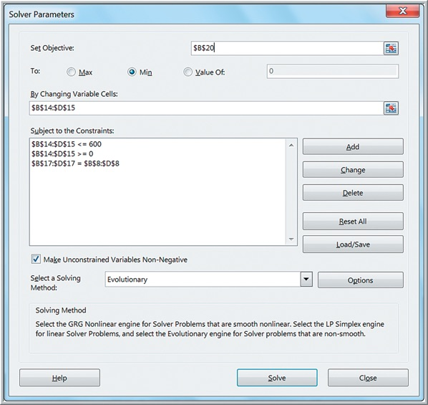
Example 14.12: Using Evolutionary Solver for the K & L Design Fixed-Cost Problem
The Evolutionary Solver algorithm requires that all variables have simple upper and lower bounds to restrict the search space to a manageable region. Thus, we set upper bounds of 600 (the total demand) and lower bounds of 0 for each of them.

Slide 47
Using Evolutionary Solver
Evolutionary Solver is a search procedure, it may get “stuck” on an inferior or even an infeasible solution. Run the method several times from the previous solution, until you receive a message that the current solution cannot be improved.
Different starting values can produce different results.
Increasing the maximum search time may improve the solution.

Slide 48
Example 14.13: A Rectilinear Location Model (1 of 3)
Edwards Manufacturing is studying where to locate a tool bin on the factory floor.
X, Y coordinates of the 5 production areas and demand for tools are shown below.
Distances to the tool bin are rectilinear (parallel to the coordinate system).
Cell | X-Coordinate | Y-Coordinate | Demand
Fabrication | 1 | 4 | 12
Paint | 1 | 2 | 24
Subassembly 1 | 2.5 | 2 | 13
Subassembly 2 | 3 | 5 | 7
Assembly | 4 | 4 | 17

Slide 49
Example 14.13: A Rectilinear Location Model (2 of 3)
Optimization model:
For Evolutionary Solver, set bounds to restrict the search space.

Slide 50
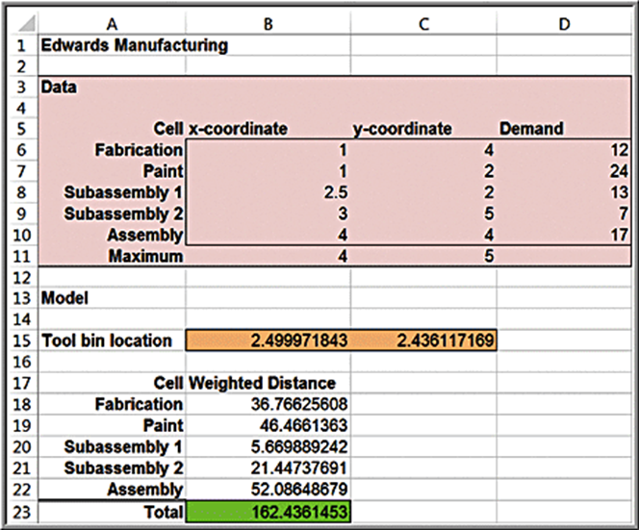
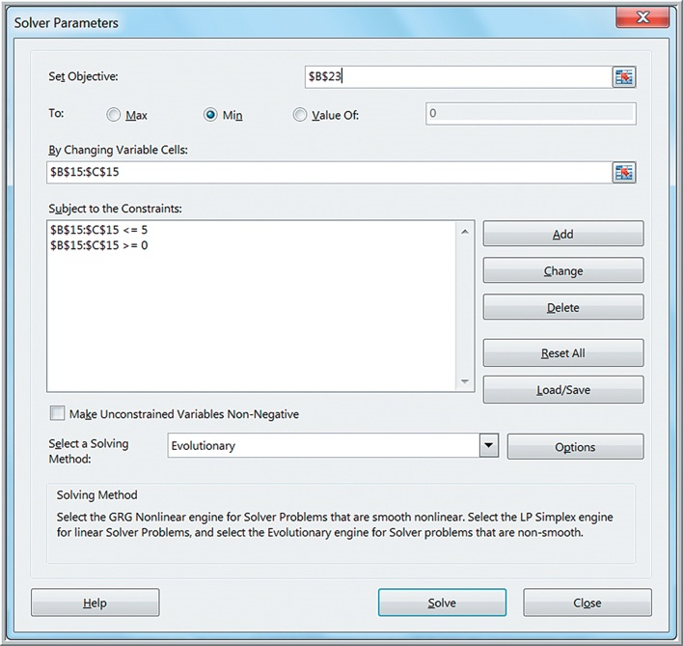
Example 14.13: A Rectilinear Location Model (3 of 3)
Spreadsheet and Solver model

Slide 51
Example 14.14: Finding Optimal Job Sequences (1 of 2)
Example 11.17 - A custom manufacturing company has 10 jobs waiting to be processed.
Processing times and due dates are shown below.
Job | 1 | 2 | 3 | 4 | 5 | 6 | 7 | 8 | 9 | 10
Time | 8 | 7 | 6 | 4 | 10 | 8 | 10 | 5 | 9 | 5
Due date | 20 | 27 | 39 | 28 | 23 | 40 | 25 | 35 | 29 | 30
A sequence of integers for the job ordering is called a permutation.
The objective is to find the permutation that optimizes the chosen criteria.

Slide 52
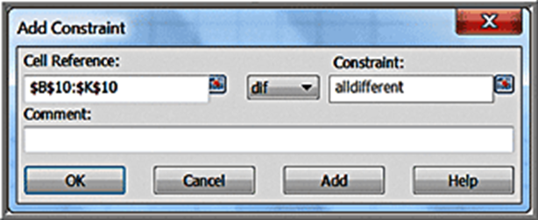
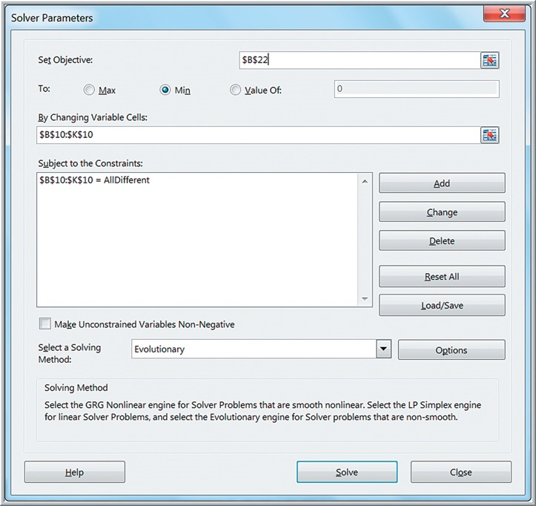
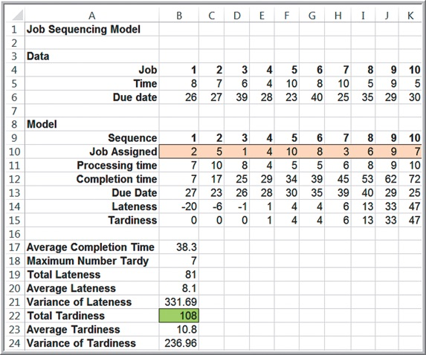
Example 14.14: Finding Optimal Job Sequences (2 of 2)

Slide 53
The Traveling Salesperson Problem (T S P)
A salesperson needs to visit n different cities and return home in the minimum total distance.
A tour is a route that visits each city once and returns to the start.
Applications include FedEx, U P S, and soft drink vendors that deliver goods to customers.
With n customers or cities, there are
tours.
If n = 14, more than 6 billion tours are possible.

Slide 54
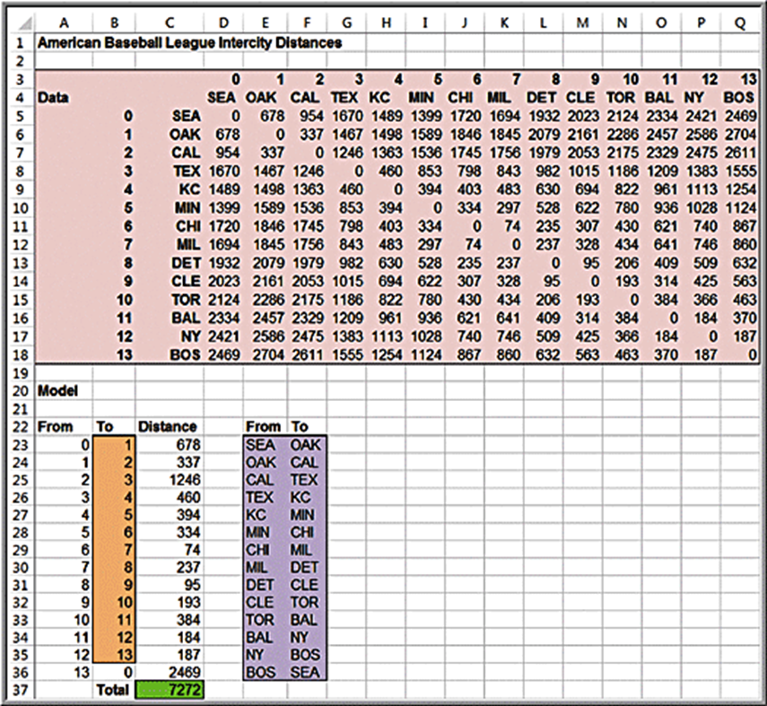
Example 14.15: Touring American Baseball League Cities (1 of 4)
A baseball fan living in Detroit wants to visit 14 ballparks of American League teams.

Slide 55

Example 14.15: Touring American Baseball League Cities (2 of 4)
Number the cities from 0 to 13.
City 0 will be the starting/ending point and any city can be assigned this position.
The 13 decision variables are the city to visit next (from cities 0 to 12).
City 13 is assigned to return to city 0.
Use the alldifferent constraint for the 13 decision variables so that each city is visited only once.

Slide 56

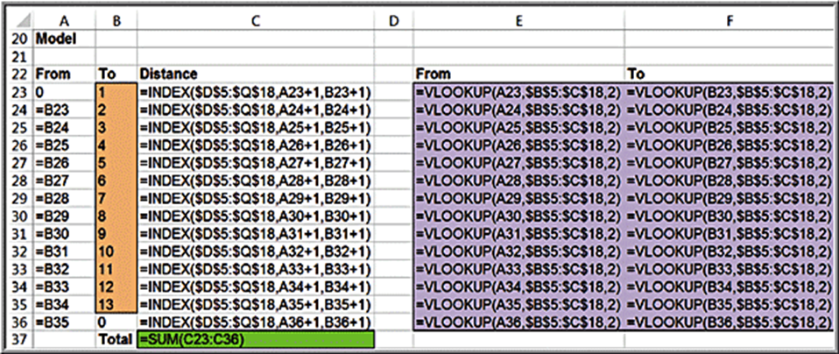
Example 14.15: Touring American Baseball League Cities (3 of 4)
Spreadsheet formulas

Slide 57
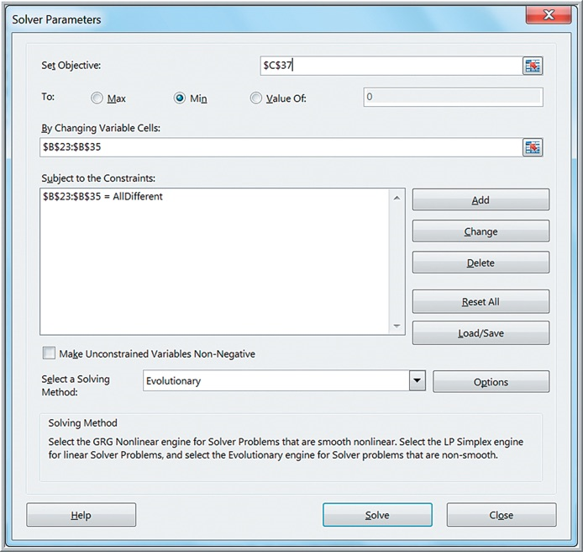
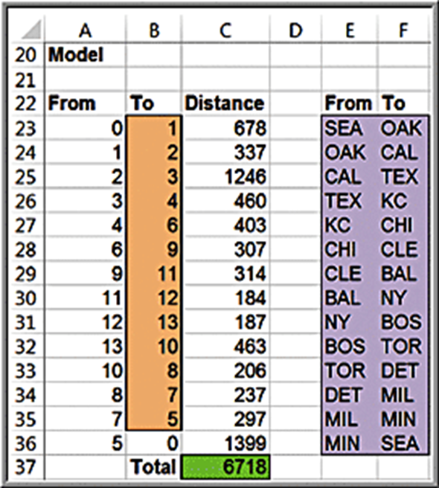
Example 14.15: Touring American Baseball League Cities (4 of 4)
Solver model and solution

